Slide 1
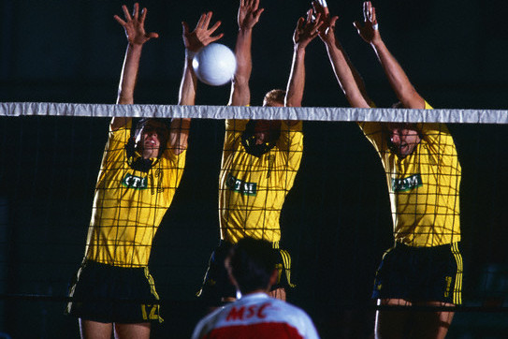
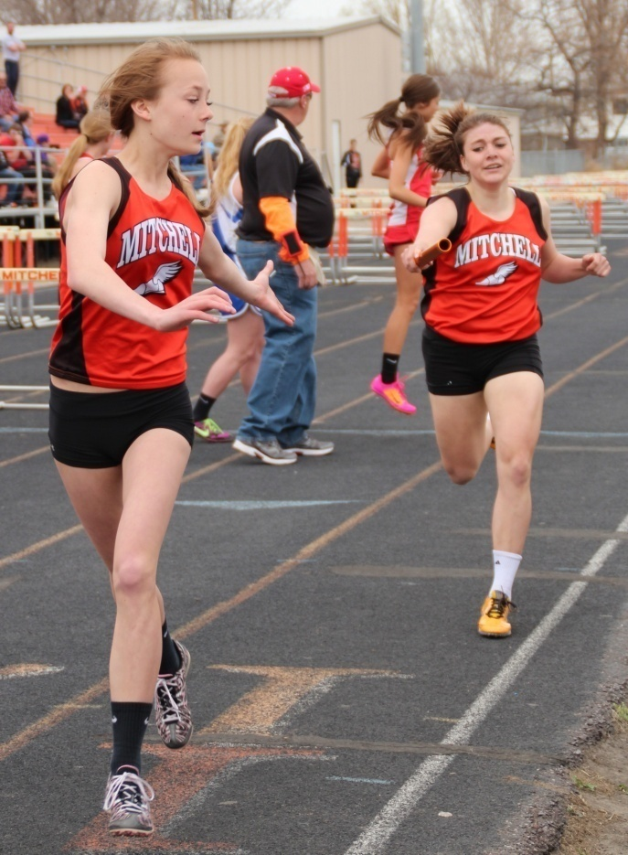
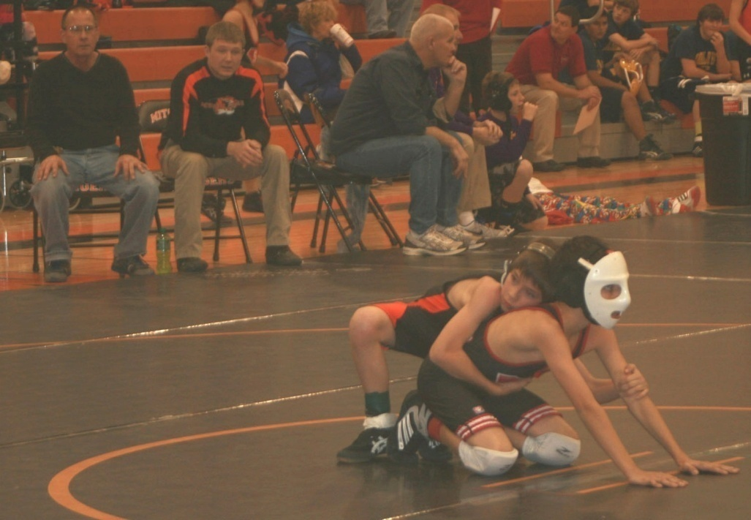
Life of an Athlete creates…
Human Performance Project in Nebraska

Slide 2
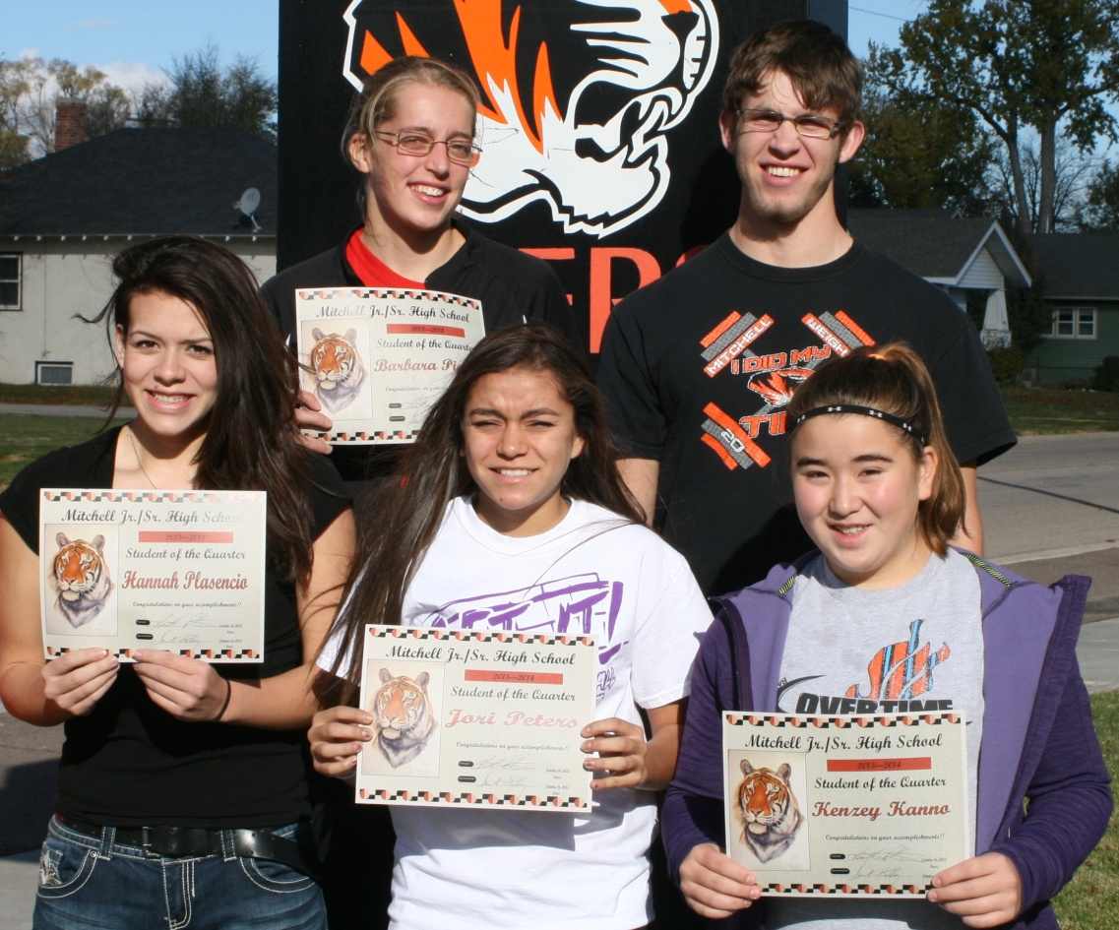
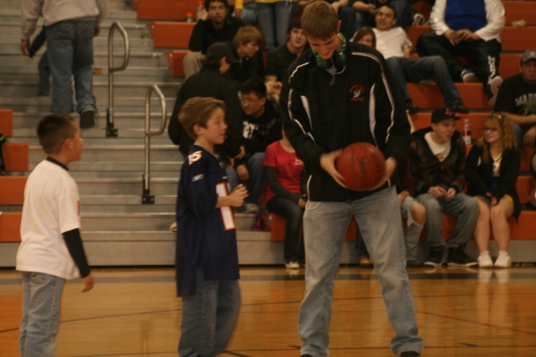
Educational Goals of Activities
Participants enhances the development of:
Competency
Character
Civility
Citizenship
Notes:
We believe that activities are an extensions of academic education

Slide 3
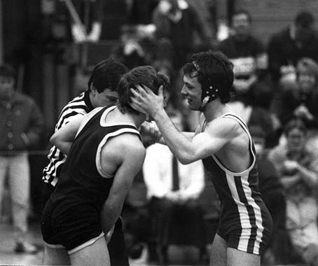
CHARACTER
A student participant in a quality program demonstrates:
Responsibility
Accountability
Dedication
Trustworthiness
Fair Play
Self Control

Slide 4
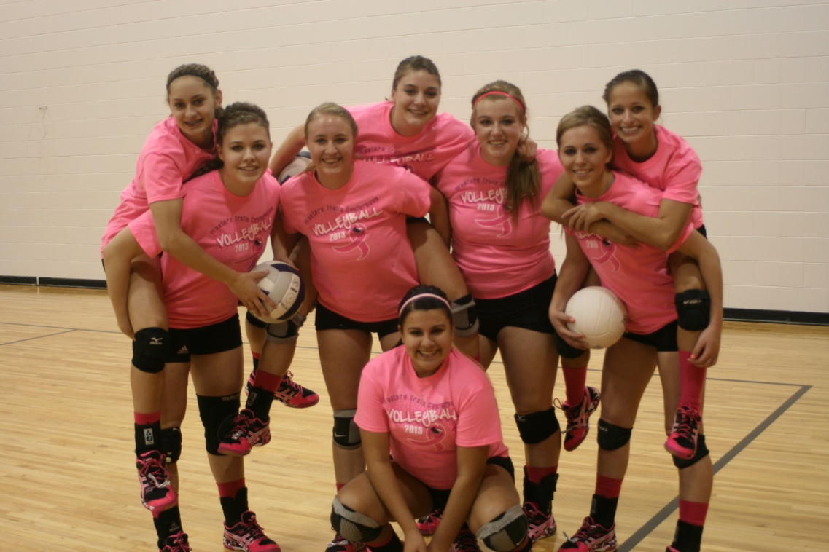
CIVILITY
A student participant in a quality program demonstrates civility towards others, showing:
Respect
Fairness
Caring

Slide 5
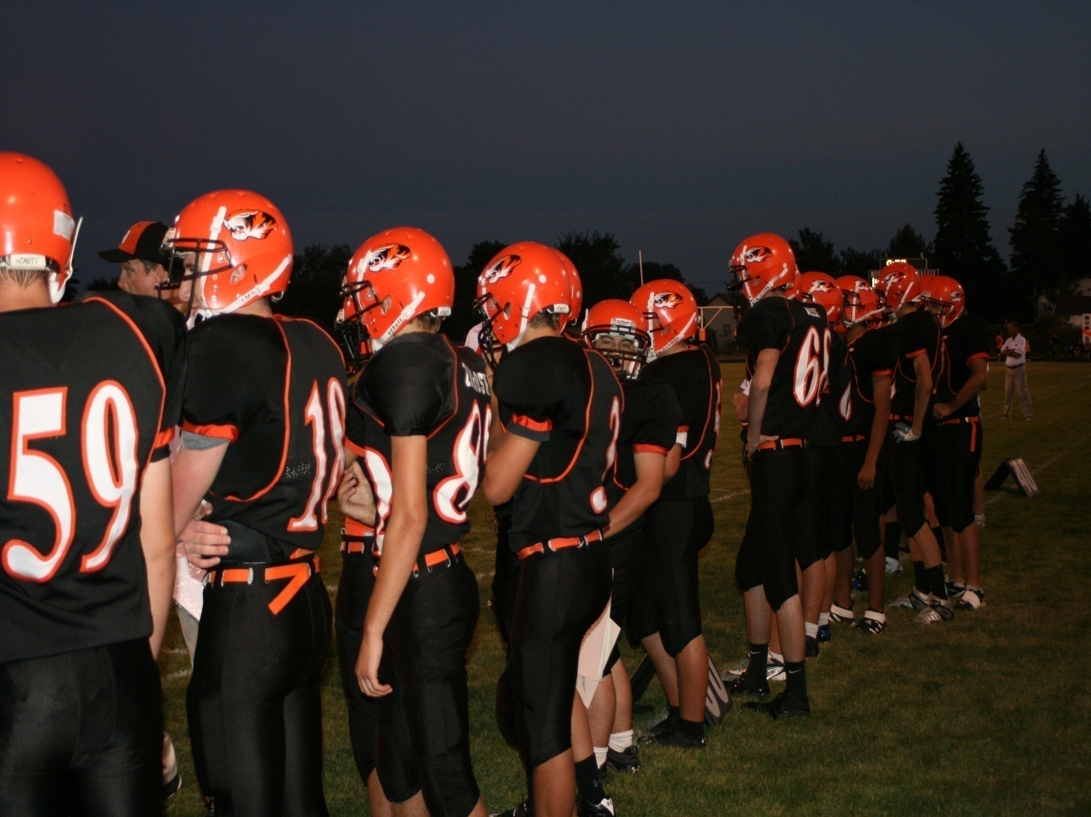
COMPETENCE
A student participant in a quality program is competent in terms of:
Skill Development
Knowledge of the game & Strategies
Fitness & Conditioning
Healthy behaviors

Slide 6
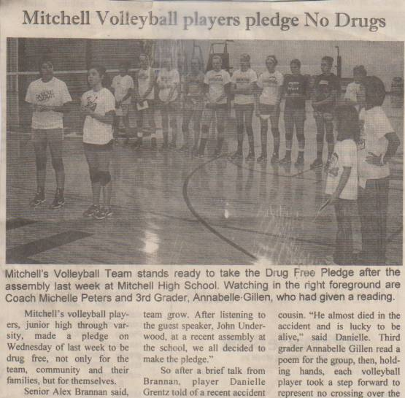
CITIZENSHIP
A student participant in a quality program demonstrates citizenship through actions showing evidence of:
Loyalty
Commitment
Teamwork
Role Modeling

Slide 7
Leadership
A student participant in a quality program demonstrates leadership through actions and verbal communication:
Dependability
Honesty
Unselfish
Show Good Judgment
Enthusiasm

Slide 8
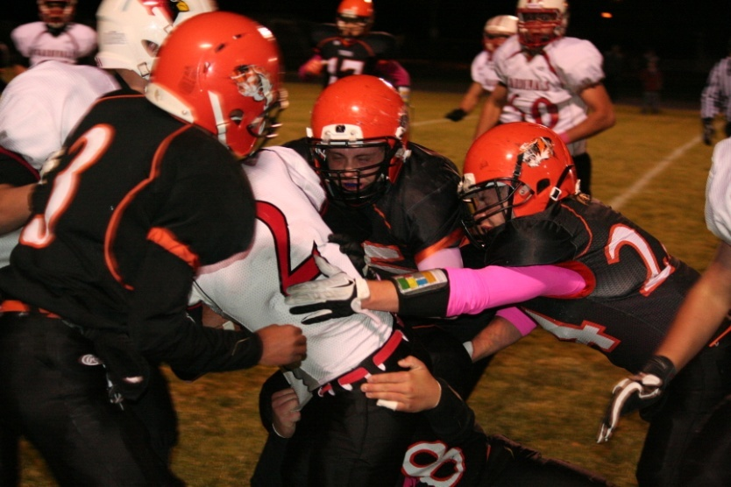
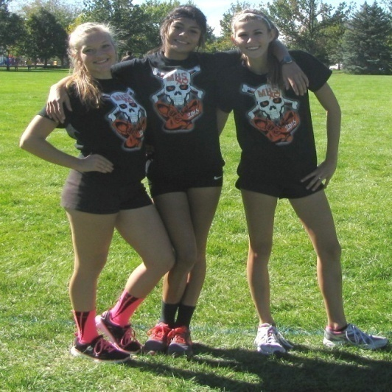
AT RISK
Athletes remain one of the most at risk populations within the general population.
PRIVILEGE
Being an athlete is an opportunity to experience a special part of life.
It is a privilege.

Slide 9
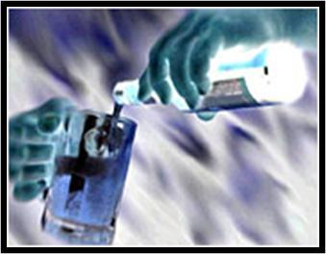
ONSET
The average age when youth first try alcohol is around 12 years for boys and 13 years for girls.
The average age at which Americans begin drinking regularly is around 16 years old.

Slide 10
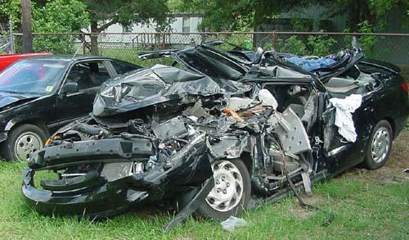
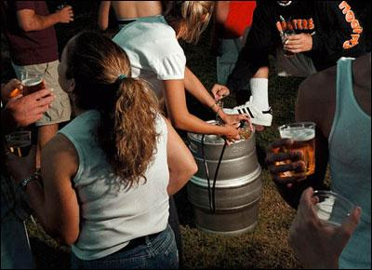
14-24
THE TEN MOST
DANGEROUS YEARS
OF LIFE

Slide 11
BIRTH – 3 YRS.
BRAIN
GROWTH
12-21 YRS.

Slide 12
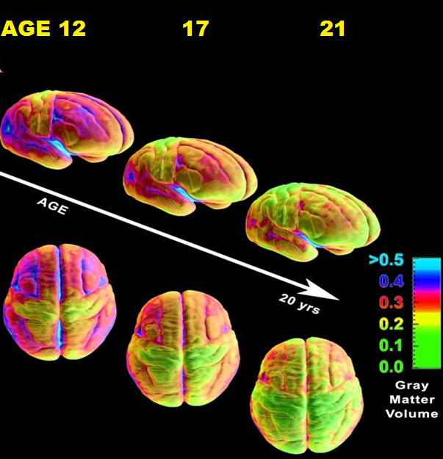
Frontal Cortex
Thinking and reasoning

Slide 13
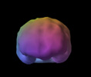
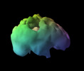
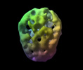
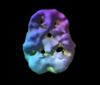
ALCOHOL USE

Slide 14
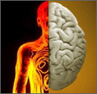
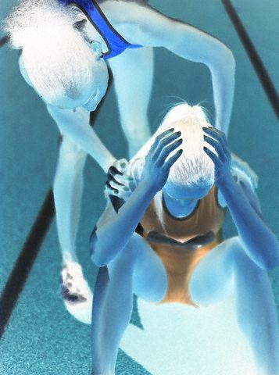
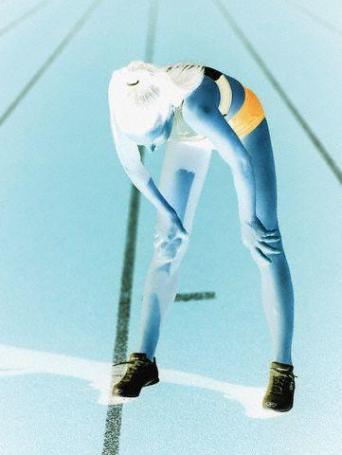
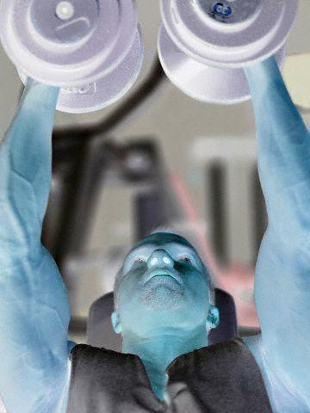
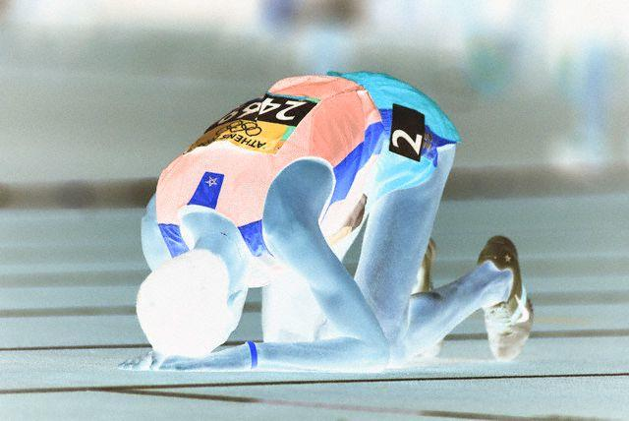
1X DRUNK = 14 DAYS
LOST TRAINING EFFECT
American Athletic Institute has studied the impact of alcohol on condition in elite athletes. Impact has shown significant projections in lost physiological condition that correlates to as much as 14 days of lost training effect…for each time drunk…
AMERICAN ATHLETIC INSTITUTE 2005
DON'T WASTE YOUR TIME

Slide 15
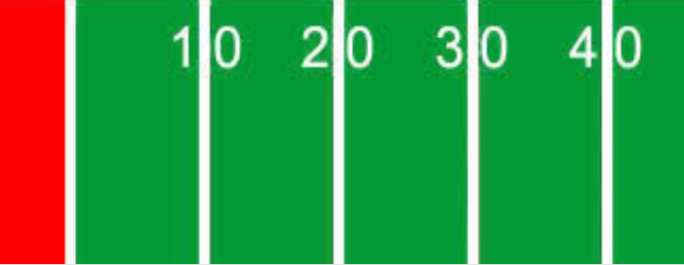
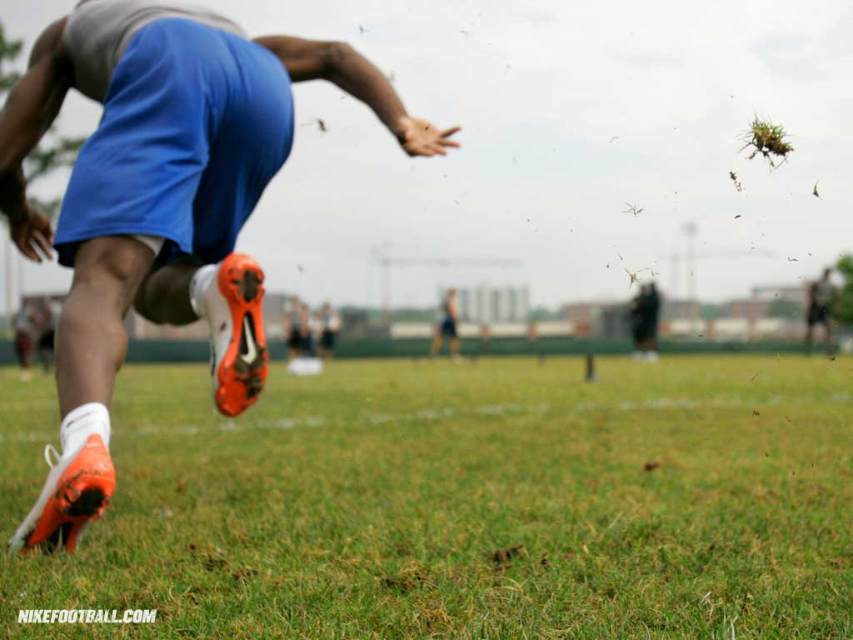
Start Up Speed 0-10 YDS. < 8%

Slide 16
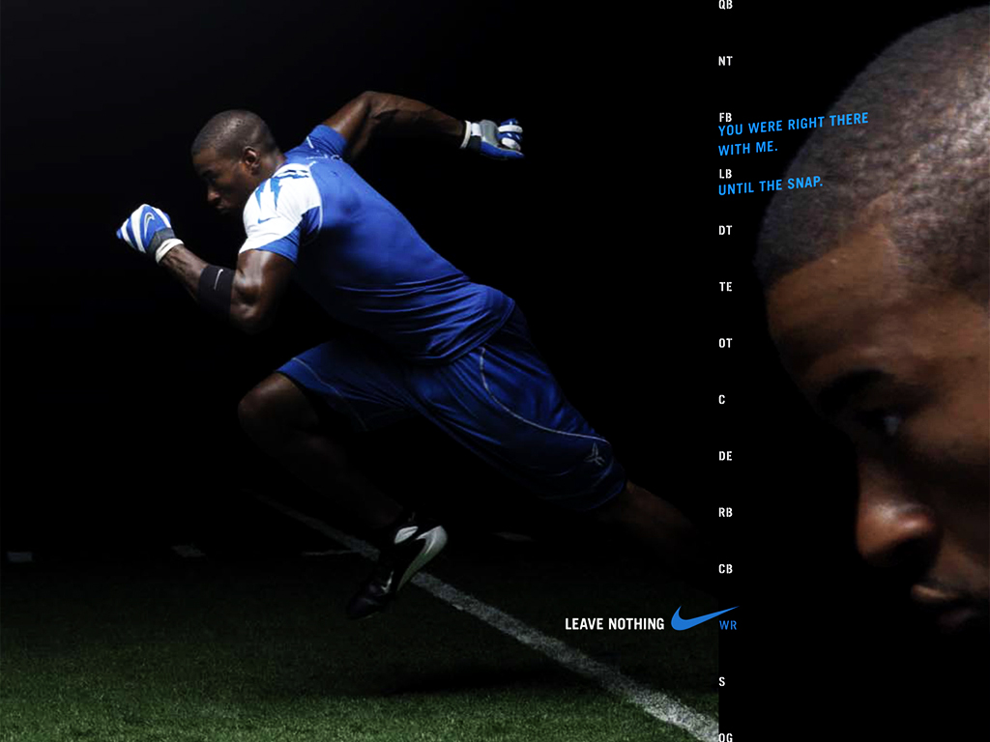
Acceleration 0-20 YDS. < 6%

Slide 17
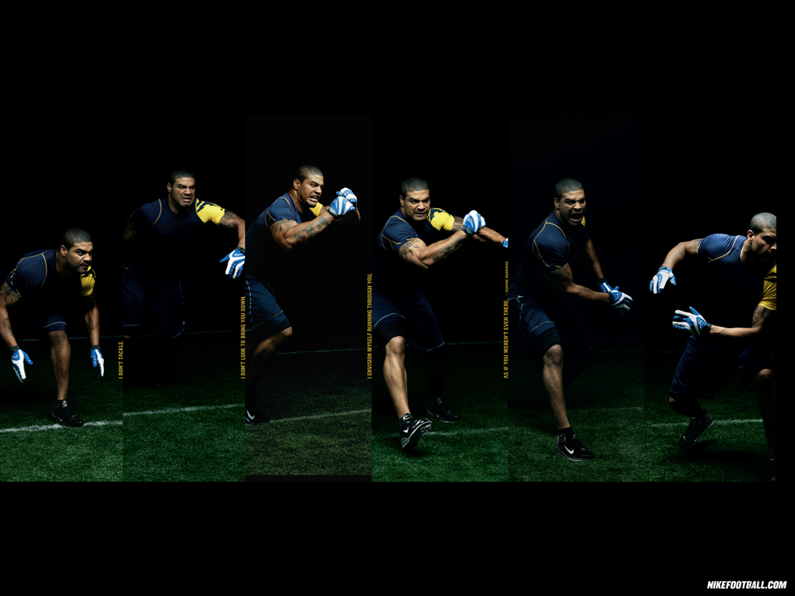
Agility Reaction < 8%
0-5 yds.

Slide 18
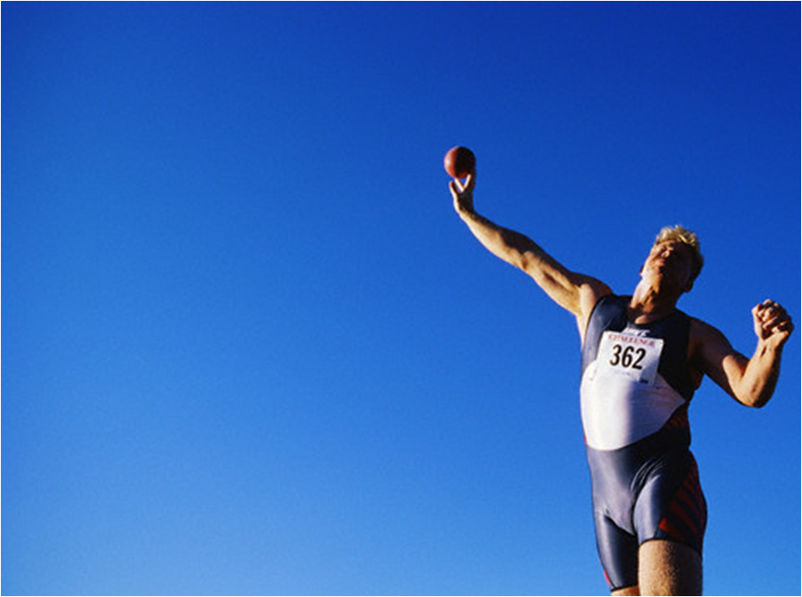
STRENGTH
Force
WEAKER
Explosive Power
Power Endurance

Slide 19
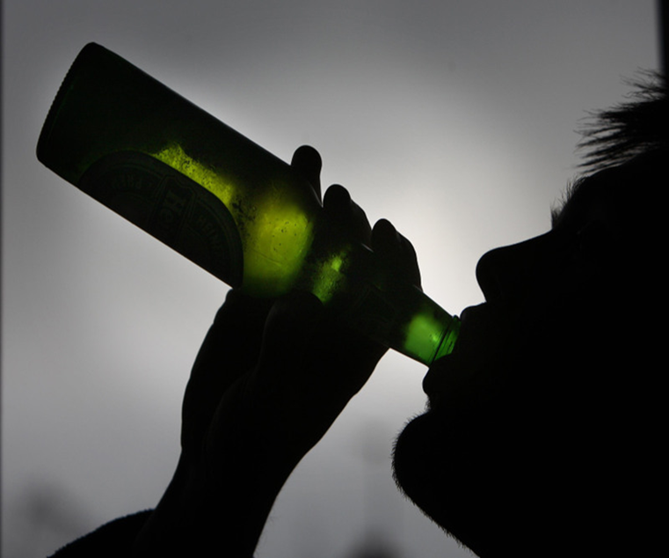
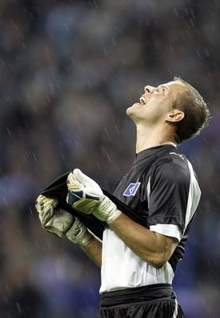
INJURIES
2X HIGHER

Slide 20
YOU LOSE...
Alcohol suppresses testosterone production in all humans.
TESTOSTERONE
VERSUS
ALCOHOL
Notes:
Nothing is more important if you are an athlete then testosterone.

Slide 21
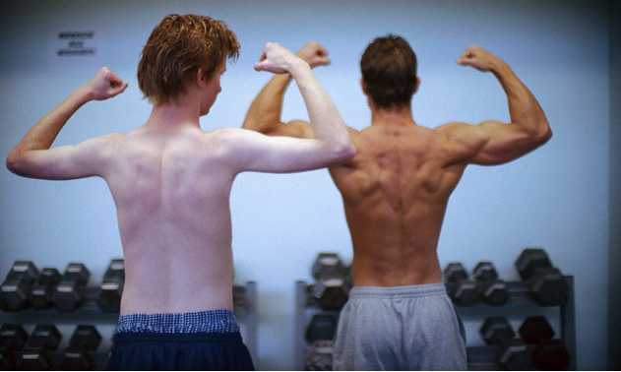
Some males who drink heavily & regularly have testosterone levels similar to female levels.
10:1 or 1:10
ALCOHOL VS. TESTOSTERONE

Slide 22
1:10
FEMALES TAKE A BIGGER HIT
FROM HEAVY DRINKING
Alcohol stays in the female body longer
Females have less of the enzymes to breakdown alcohol

Slide 23
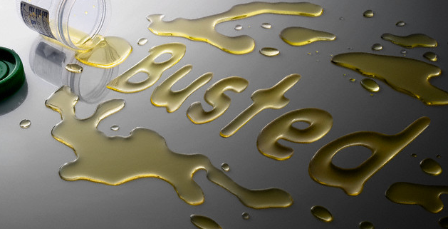
Today’s Pot
Marijuana THC content 1960-70’s 1-4% THC
Marijuana THC content today 40+% THC

Slide 24
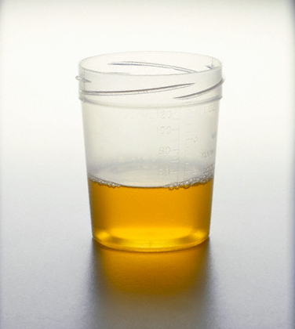
How long does it stay in your system?
Today’s pot is not like yesterdays… stronger and stronger concentrations of THC have made marijuana a potent drug that deposits in brain tissue and effects brain function.

Slide 25
Marijuana Cannabinoids
THC Marijuana
Detection Times
Daily 49-63 days

Slide 26
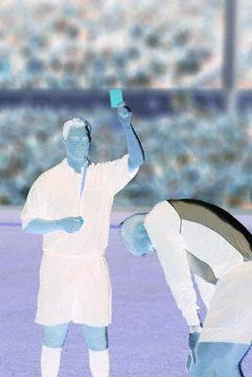
DECREASED PERFORMANCE
LOSS OF CONDITION
WEIGHT LOSS
MISSING PRACTICES OR LATE
FREQUENT SICKNESS
DECREASED INTERACTION WITH COACH TEAMMATES
LOSS OF MOTIVATION
LESS RECEPTIVE TO COACHING
DEFENSIVE
OUT OF CHARACTER BEHAVIORS
TEAM CONFLICT
ASSOCIATION WITH KNOWN PARTYERS
AGGRESSIVE BAHAVIORS
BAD ATTITUDE
SPORT SIGNS

Slide 27
PHYSICAL SIGNS
TIRED
PUPILS DIALATED CONSTRICTED
GLASSY /BLOODSHOT EYES
DULL EYES
AIMLESS POSTURING
SMELL ON BREATH
LACK OF CONCERN FOR APPEARANCE DRESS
SUNGLASSES
BAD PALOR
FATIGUE
WIRED
ALOOF

Slide 28
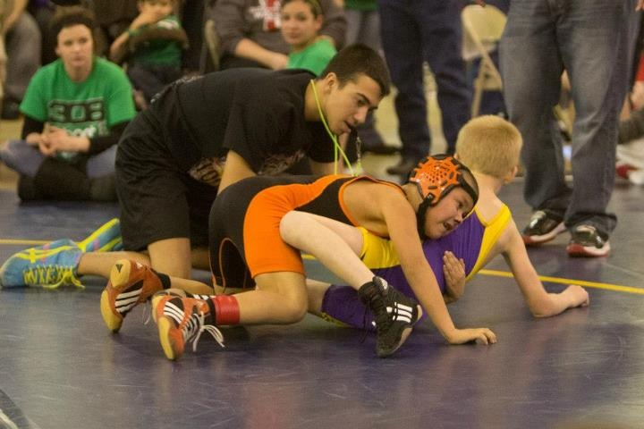
Training Tips
Little things that make a big difference

Slide 29
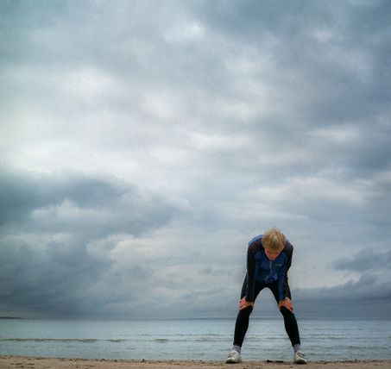
Recovery NUTRITION
TR
3
TRAIN
REFUEL
REHYDRATE
REST

Slide 30
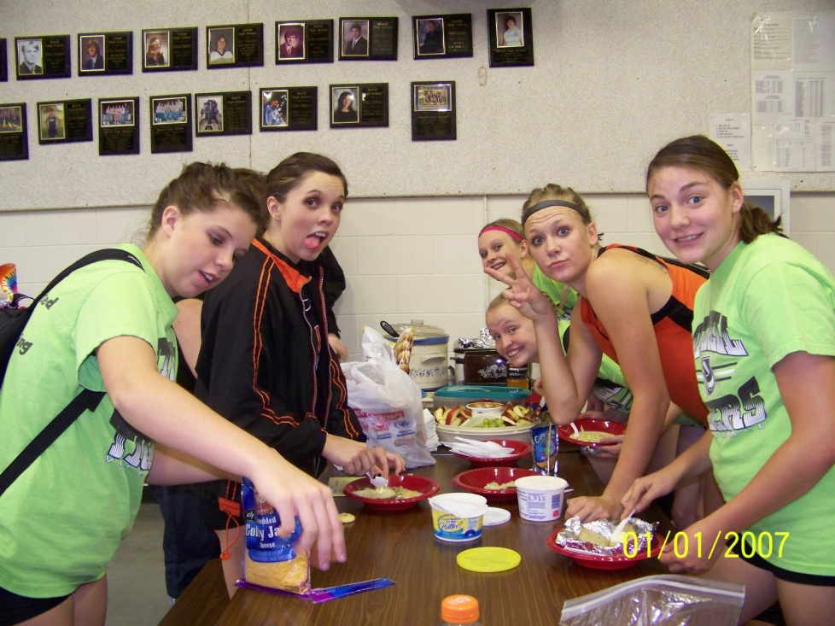
POST TRAINING NUTRITIONAL RECOVERY
MAY BE THE MOST CRITICAL
FACTOR IN TRAINING EFFECT

Slide 31
Sweet Drink 4-6 oz. (pop, Gatorade, kool-aid)
Protein 12-16 oz(choc milk, beef jerky, protein bar, string cheese )
Carbs 75g (nuts, raisins, gummy bears, pretzels, crackers)
Meal within one hour (Dinner)

Slide 32
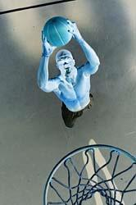
Sleep is clearly a predictor of performance in skill based activity.
Research has proven that the amount of sleep an athlete gets has an effect on performance.
Sleep &
Play
Better

Slide 33
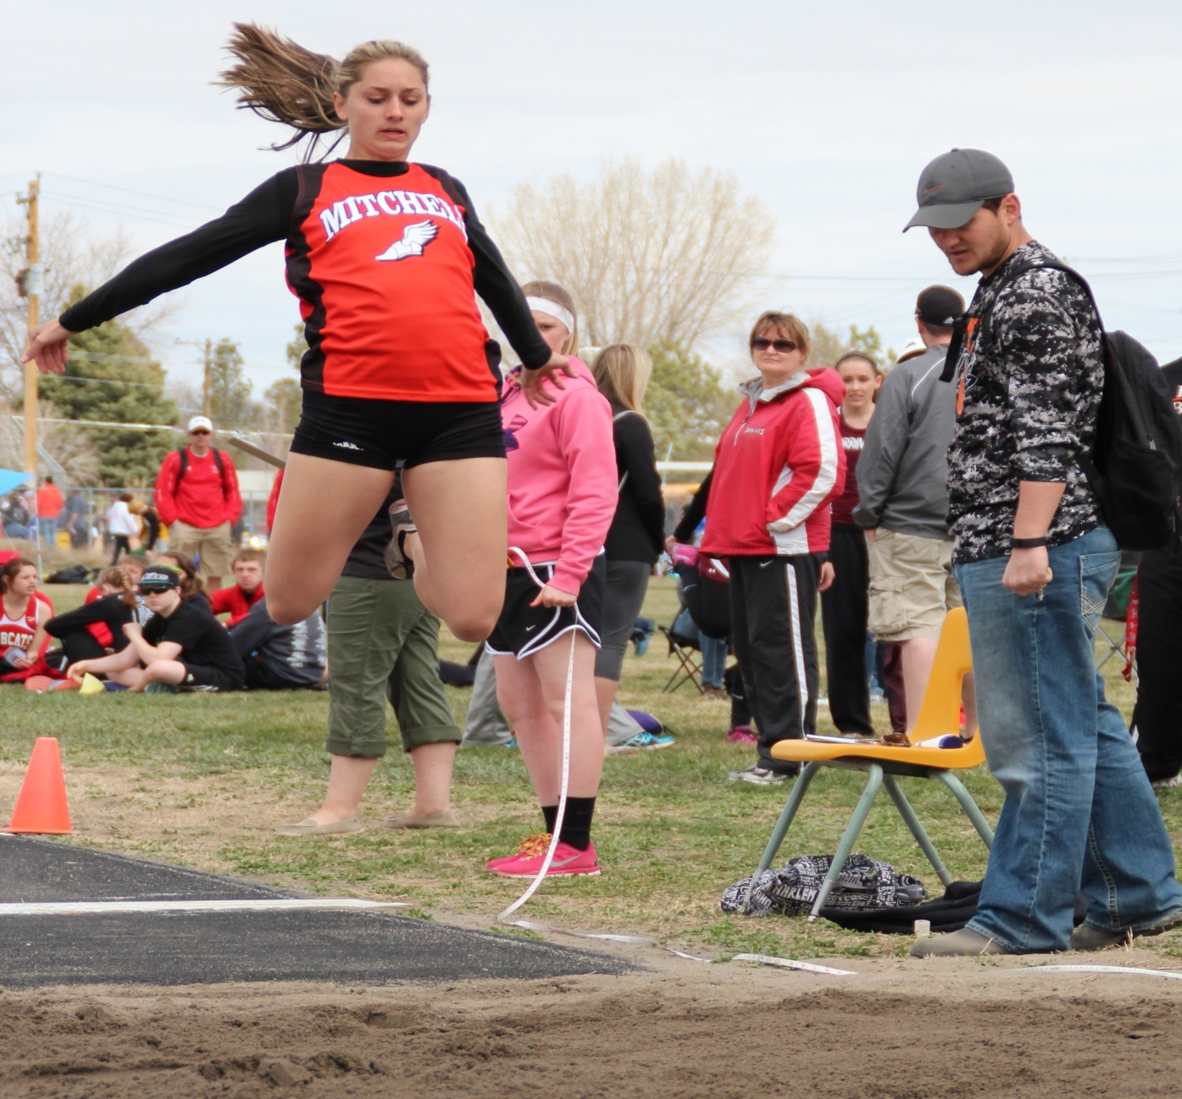
Better information
Better decisions

